Slide 1


MULTI-FACTOR REAL ESTATE COMPARITIVE TOOL

Slide 2
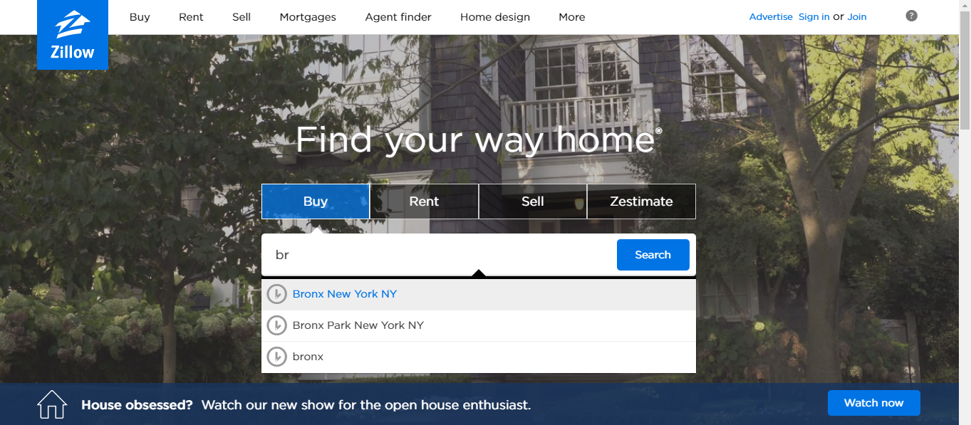

Slide 3
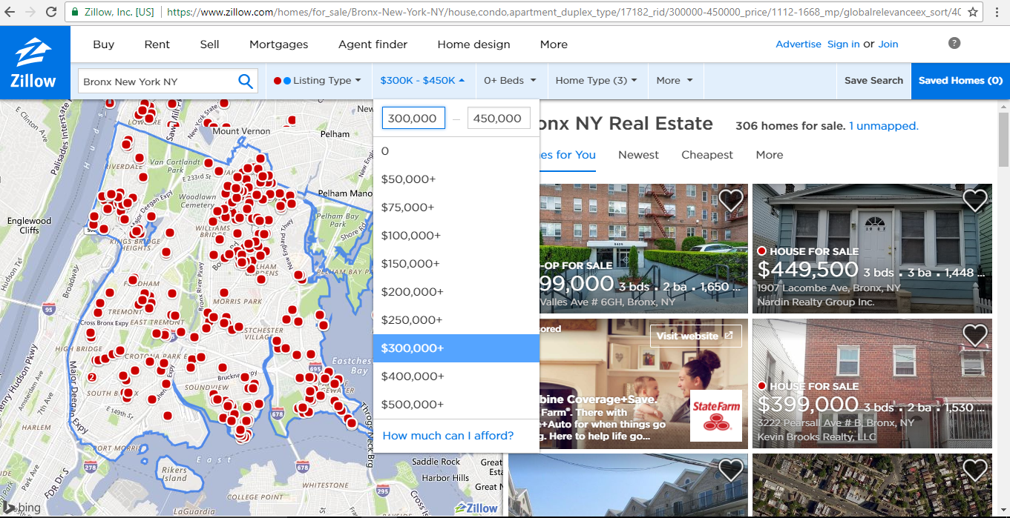

Slide 4
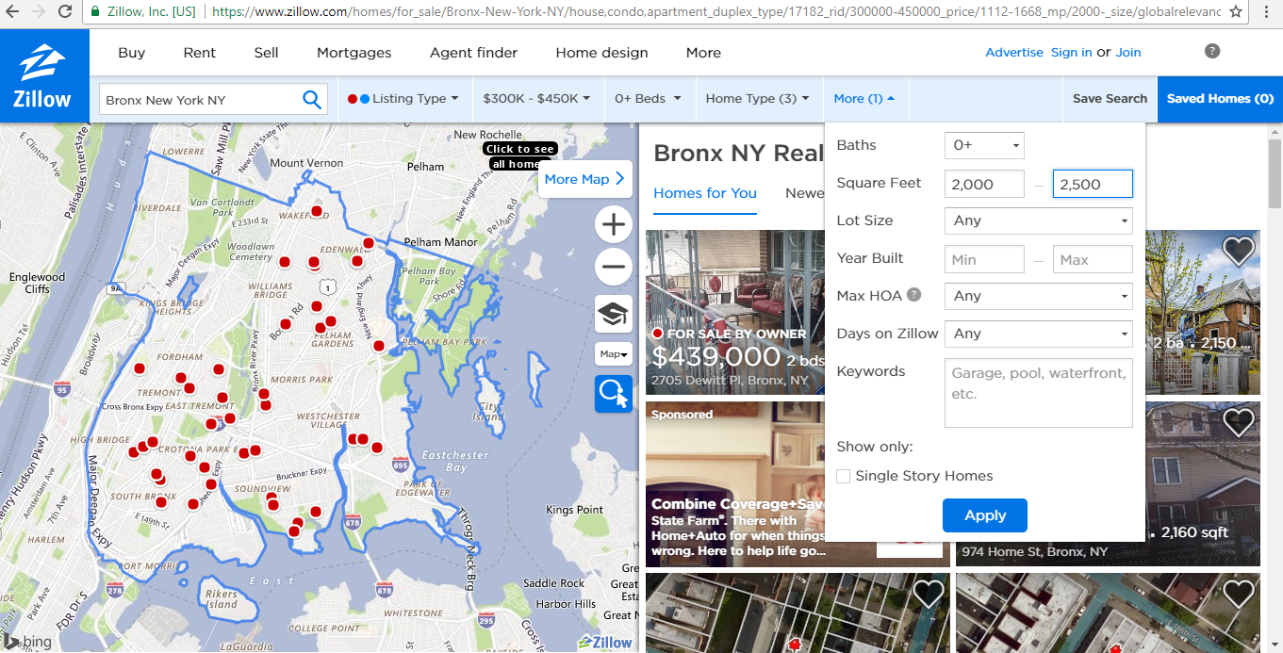

Slide 5
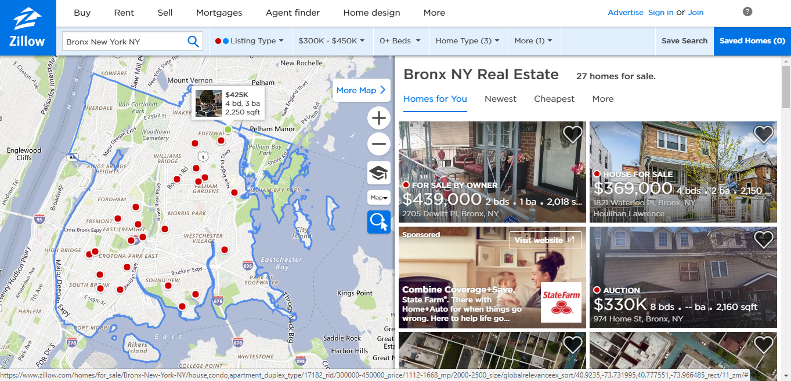

Slide 6
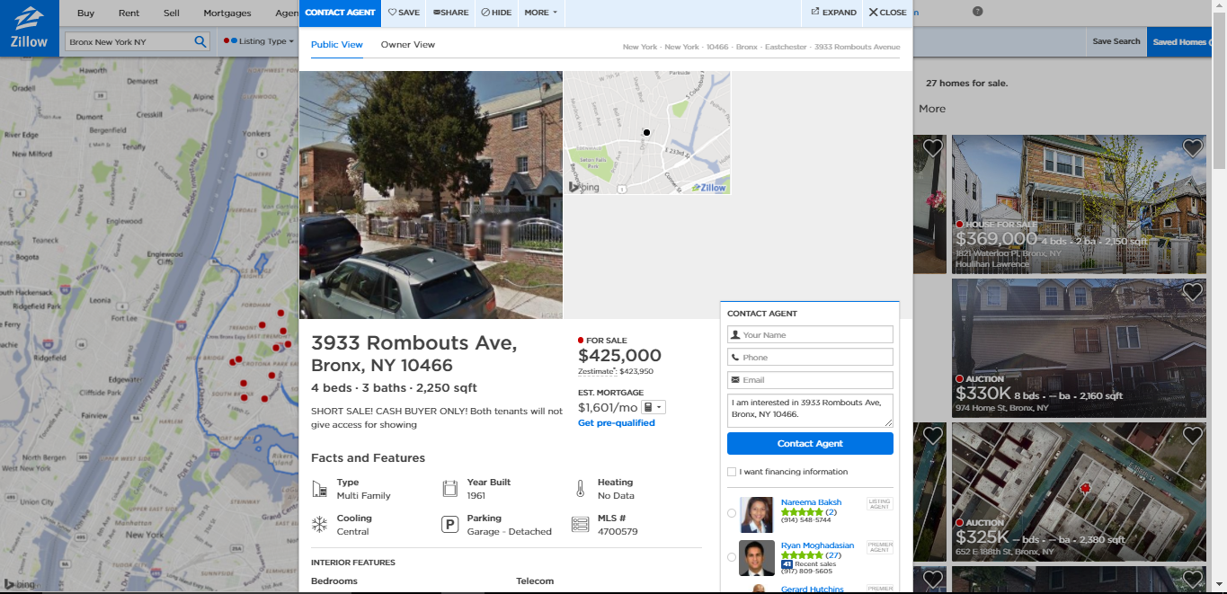
Magic Number Seven (+-2)

Slide 7
EDUCATION
RECREATION
SIZE
HEALTH
PRICE
PRICE
TRANSPORT
SAFETY
YEAR BUILT
AMENITIES

Slide 8
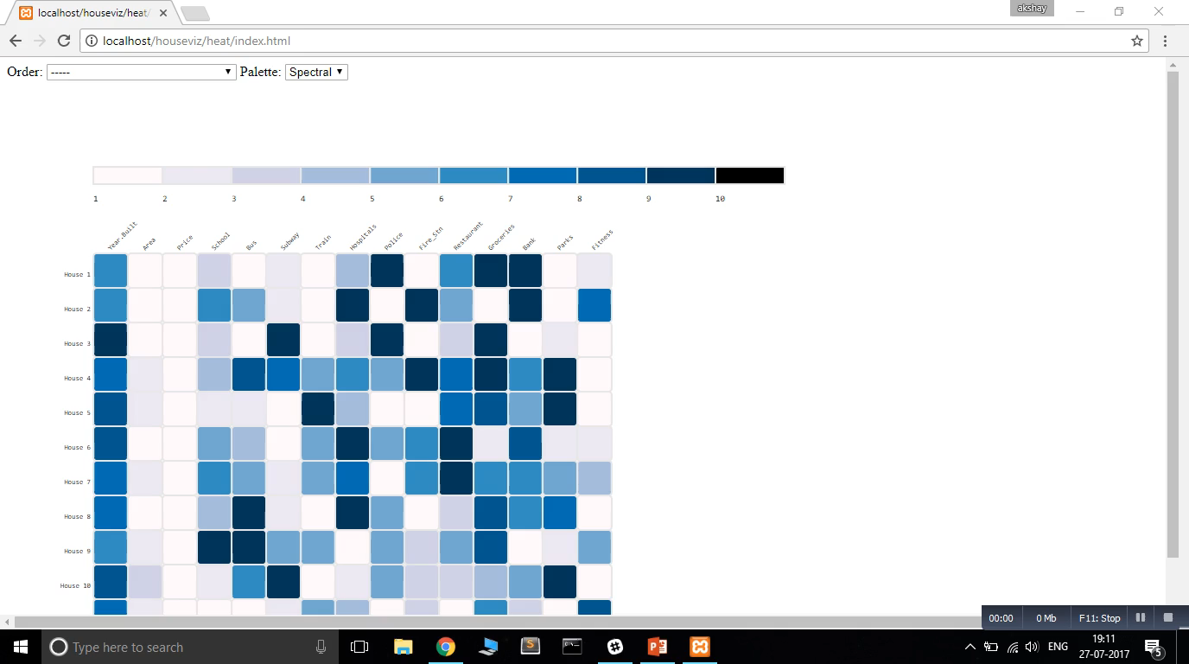

Slide 9
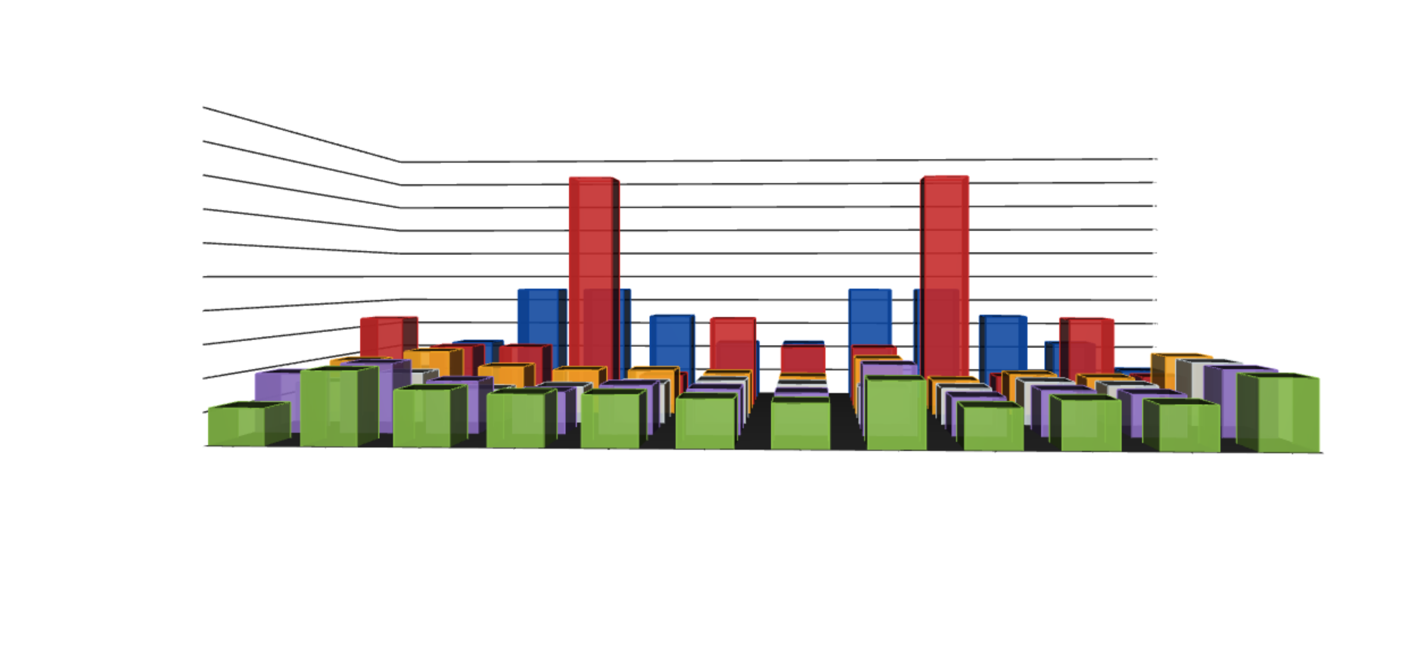
10
9
8
7
6
5
4
3
2
1
0
Price
Parks
Area
Year Built
Groceries
School
Hospital
Restaurants
Transport
Fitness
Fire Station
Police Station

Slide 10
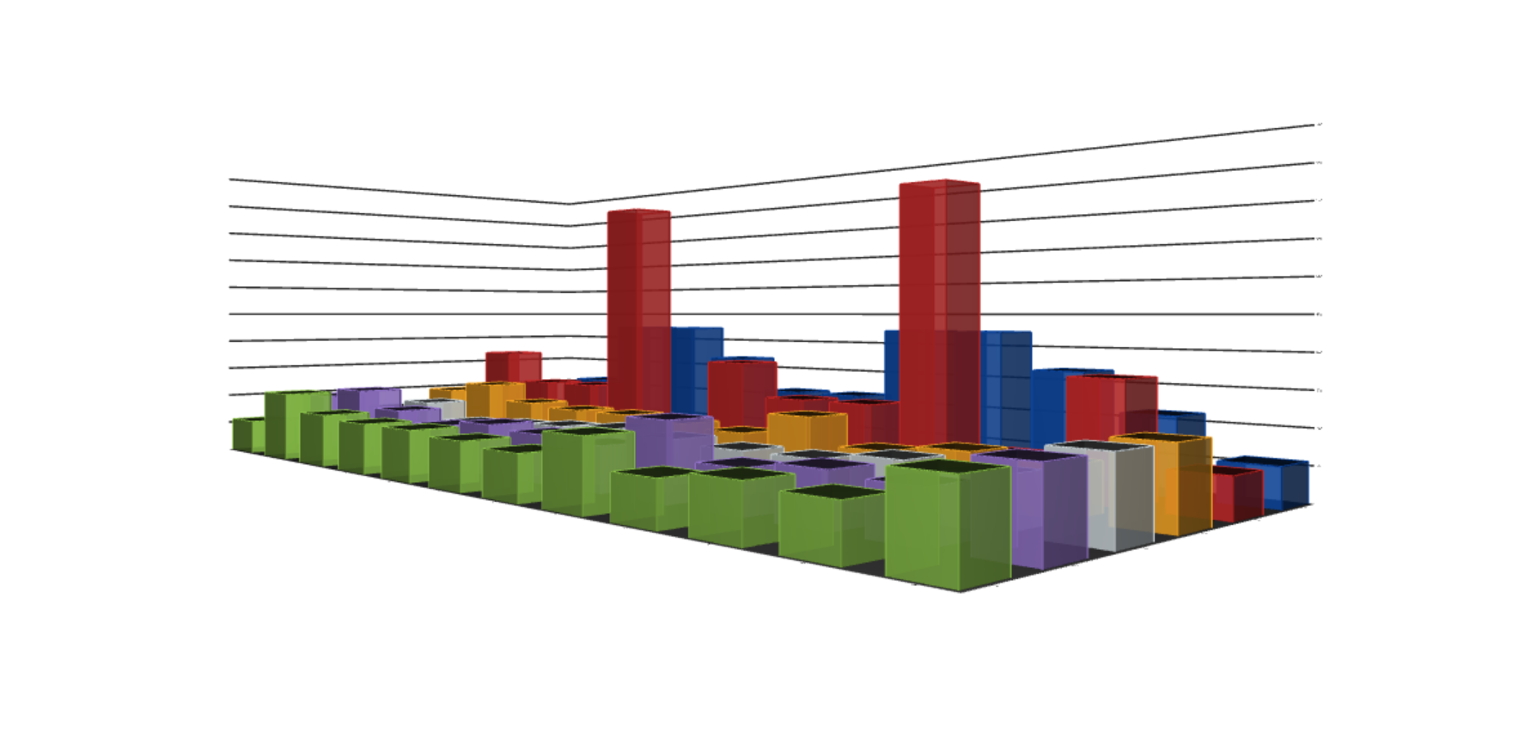
10
9
8
7
6
5
4
3
2
1
0
Price
Area
Year Built
Groceries
School
Hospital
Parks
House 6
Restaurants
Transport
House 5
Fire Station
House 4
Police Station
Fitness
House 3
House 2
House 1

Slide 11

“Choosing your Dream Home
Just got way easier…”

